Slide 1
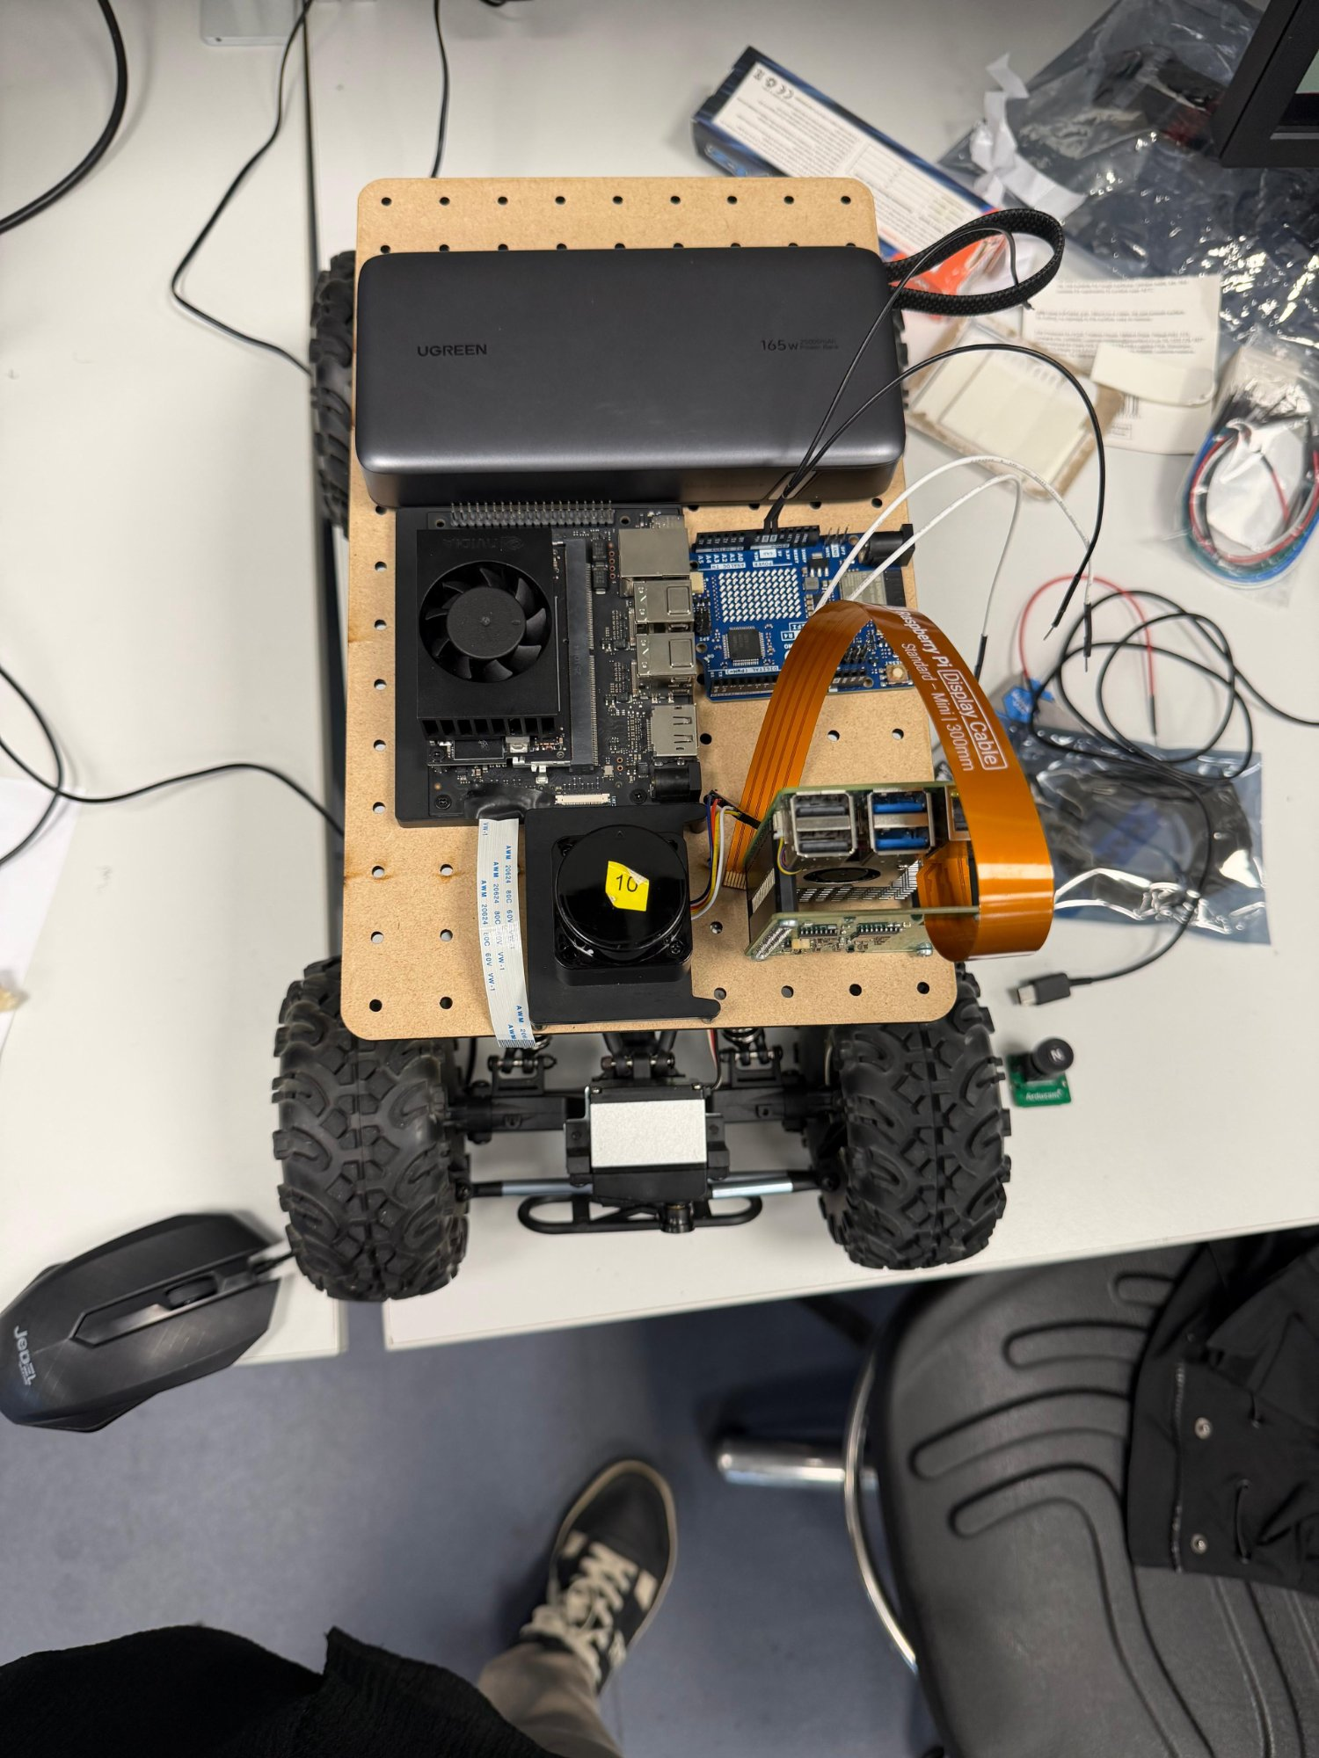
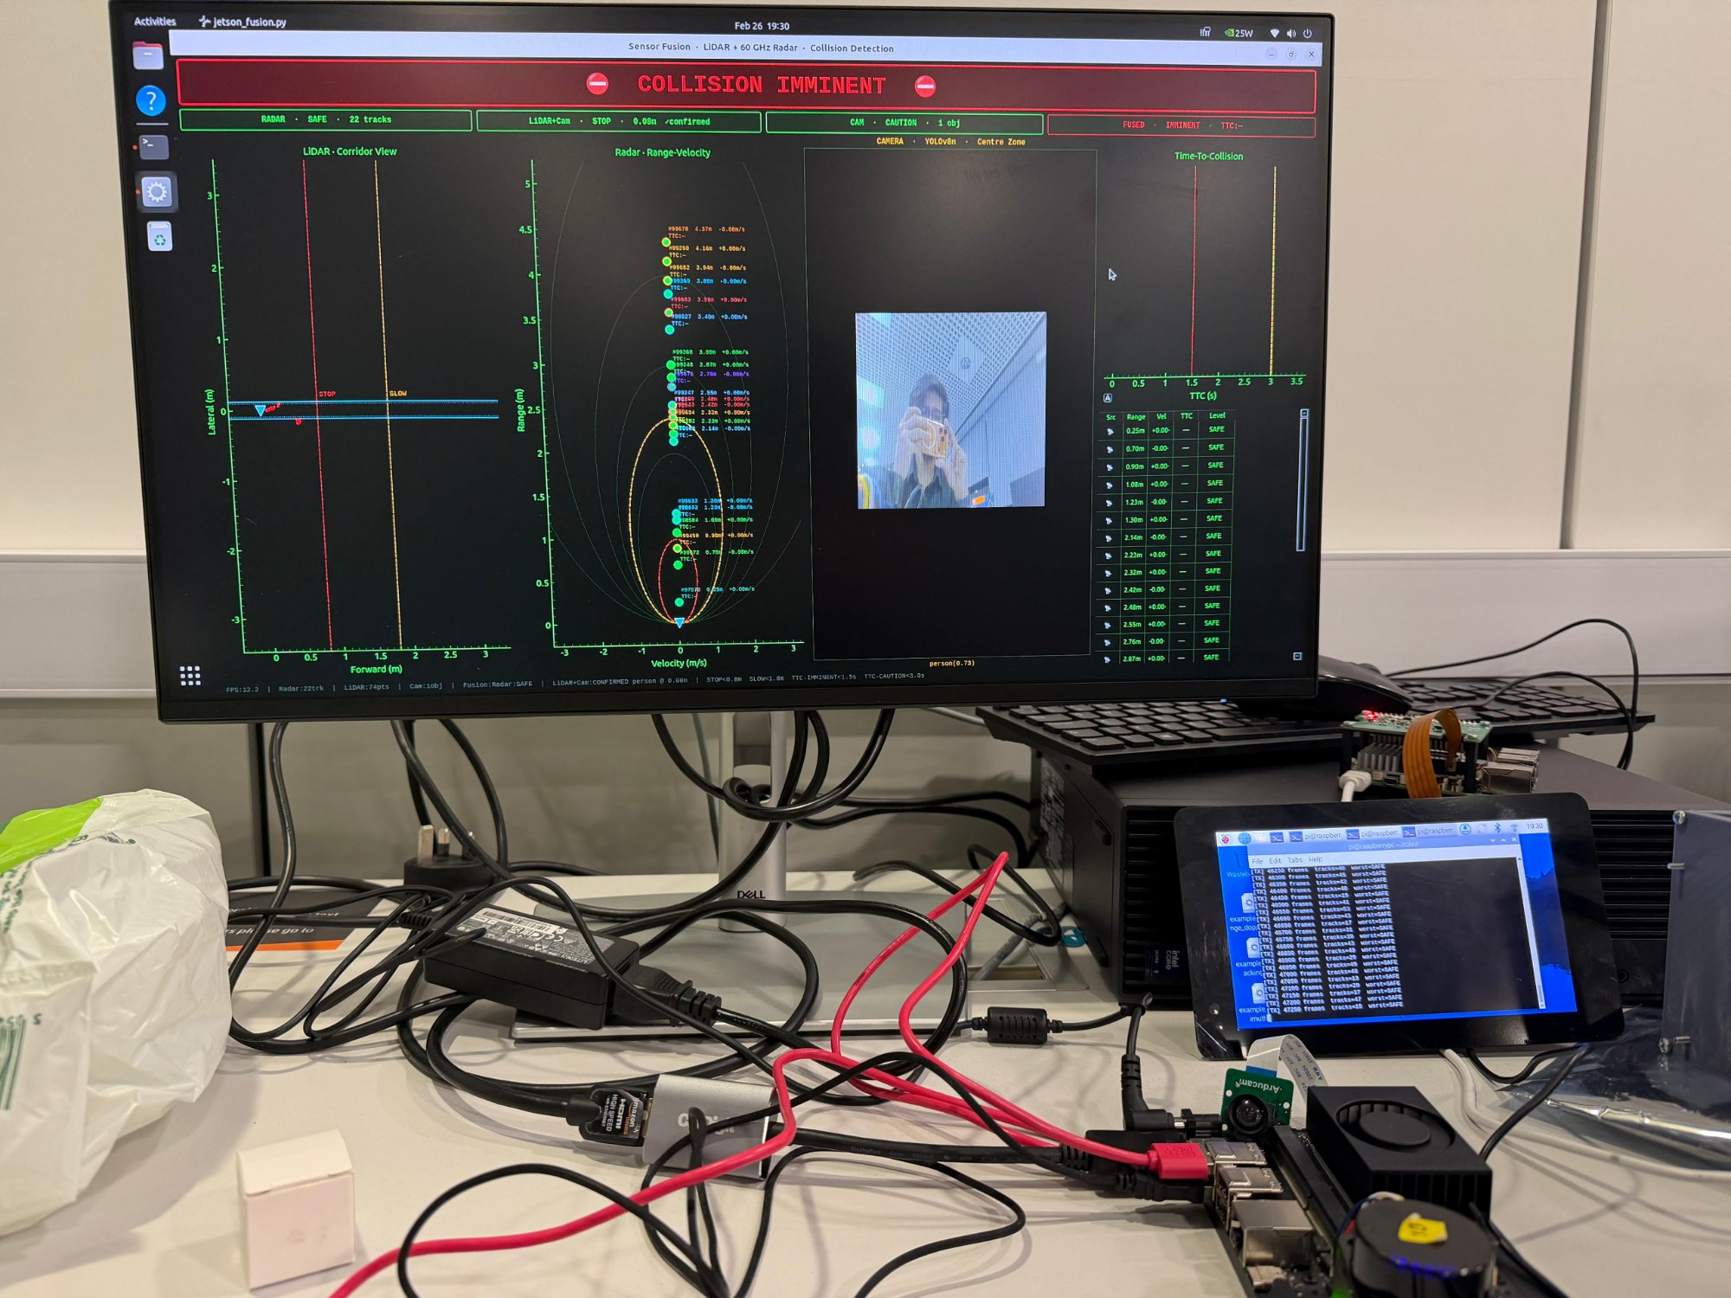
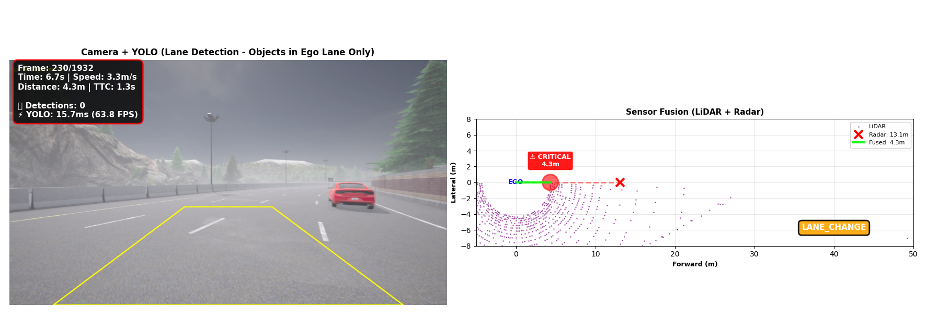
Sensor-Driven
Digital Twin
for Collision
Prevention
in Autonomous Systems
Raffay Hassan
M00944822 | BEng Computer Systems Engineering
Middlesex University London
Supervisor: Dr Purav Shah | March 2026
Sensor Fusion
Digital Twin
LiDAR
Radar
YOLOv8
TTC
1

Slide 2
INTRODUCTION & MOTIVATION
Why This Project Exists
Detection Is Not Enough
This Project's Response
Identifying an obstacle does not indicate danger. Distance and relative speed must be assessed together safety systems need predictive risk assessment, not just detection.
A sensor-driven digital twin for predictive collision detection camera, LiDAR, and radar on embedded hardware. TTC is the core safety metric. Validated in CARLA then on real hardware.
Digital Twins on Embedded Hardware Are Underexplored
Most digital twin research targets cloud or infrastructure scale. Implementing DT concepts on edge-constrained embedded hardware with real-time budgets remains unaddressed.
The Simulation-to-Real Gap
Simulation allows safe algorithm development but cannot replicate real sensor noise or physical constraints. Validating on actual hardware is necessary and underperformed.
2

Slide 3
Aims & Objectives
Project Aim Design and implement a sensor-driven digital twin capable of predicting collisions using multi-sensor perception and TTC analysis on embedded platforms.
01
02
03
Develop a CARLA simulation environment to model vehicle behaviour and collision scenarios, validating the perception pipeline before hardware deployment.
Implement multi-sensor perception: camera (YOLOv8n), LiDAR distance measurement (LD06), and radar velocity estimation (BGT60TR13C).
Design a digital twin world model that continuously updates with obstacle positions, distances, velocities, and TTC risk values.
04
05
Implement Time-To-Collision computation using fused sensor measurements as the primary predictive safety metric.
Deploy on Jetson Orin Nano + Raspberry Pi 5 and evaluate performance across simulation and real-world experiments.
3

Slide 4
LITERATURE REVIEW & BACKGROUND
What Already Exists And What's Missing
Camera / Deep Learning
Industry Comparison (from report Table 1)
Strong classification (YOLO, Faster R-CNN). Cannot directly measure distance. Degrades in low light, glare and occlusion. (Grigorescu et al., 2020)
System | Sensors | Focus
Waymo | Cam+LiDAR+Radar | Full autonomy
Tesla Vision | Camera only | End-to-end neural net
Mobileye | Cam+Radar | Driver assistance (ADAS)
This Project | Cam+LiDAR+Radar | Predictive TTC + Digital Twin
LiDAR-Only Systems
Accurate 3D geometry. Expensive, computationally heavy, vulnerable to reflective surfaces and rain. No semantic understanding of object type.
Simulation-Only Research
CARLA enables safe algorithm development but cannot replicate real sensor noise or physical constraints. (Dosovitskiy et al., 2017)
Research Gap This Project Addresses
Lightweight embedded architecture fusing all three modalities with a live digital twin and TTC-based predictive risk, validated on real hardware. (Grieves & Vickers, 2017)
Key refs: Grigorescu et al. (2020); Badue et al. (2021); Lefèvre et al. (2014); Grieves & Vickers (2017)
4

Slide 5
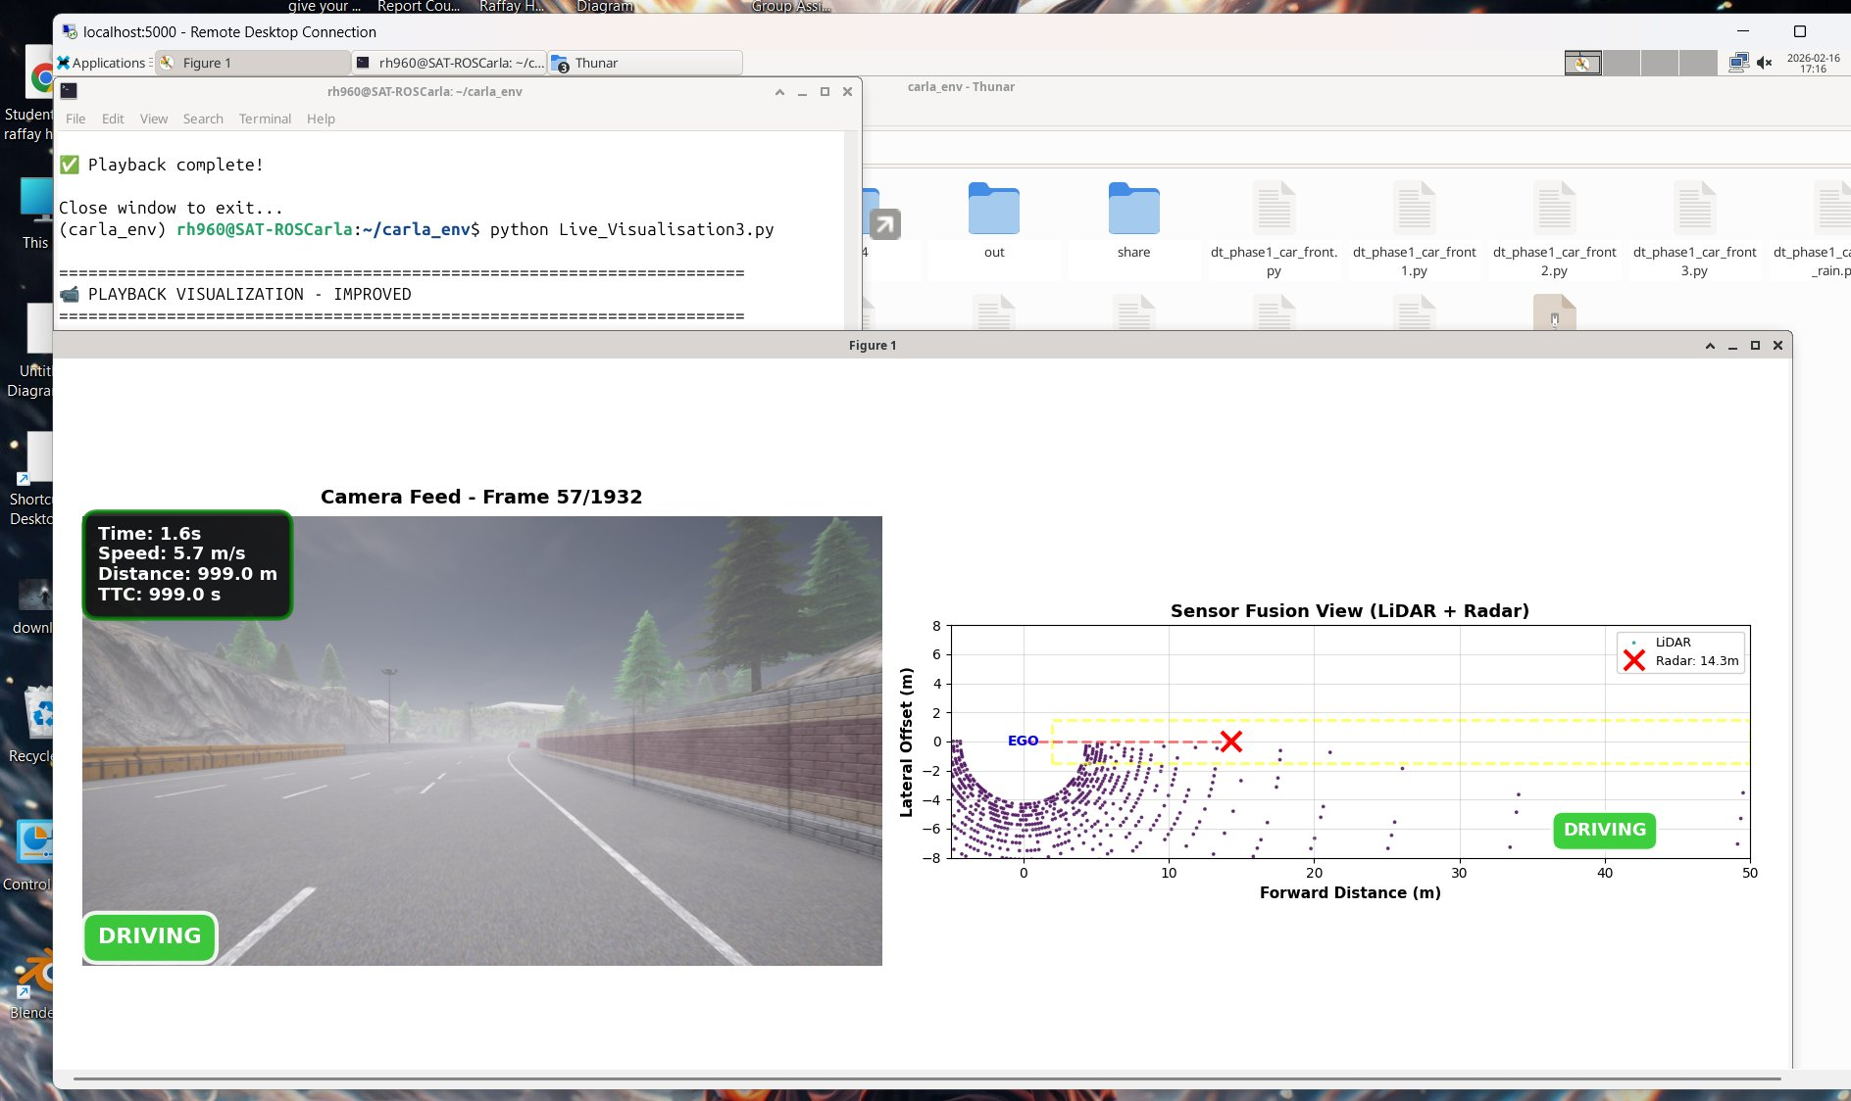
What Is the Digital Twin in This Project?
Common Misconception
The Actual Digital Twin
CARLA = Digital Twin?
CARLA is a simulation engine. It generates scenarios and visualises environments. It does not maintain an independent sensor-driven persistent world model.
A simulator produces data. The Digital Twin interprets it.
Continuously updated internal world model a software layer, not a separate app
Stores: obstacle positions, distances, velocities, TTC values, confidence scores, timestamps
Hazard memory persists across frames not just frame-by-frame reactive detection
Updates identically from real sensors OR CARLA simulation data
Enables predictive TTC-based safety reasoning before a collision becomes unavoidable
Sensors → Perception →
Digital Twin → TTC Eval → Decision
Same architecture: CARLA data or real sensor data zero core logic change.
5

Slide 6
What Is the Digital Twin in This Project?
A simulator produces data. The Digital Twin interprets it.
5

Slide 7
PHASE 1 ARCHITECTURE
Phase 1: Simulation Pipeline Architecture
CARLA
Simulator
Sensor
Stack
Sensor
Fusion
State
Machine
Vehicle
Control
▶
▶
▶
▶
Town04
Synchronous
LiDAR + Radar
+ Camera
Fused distance
+ TTC compute
SAFE→WARNING
→CRITICAL
Emergency brake
Lane change
Simulated LiDAR
Simulated Radar
Simulated Camera + YOLOv8n
CARLA RayCastLidar sensor — forward cone
Point cloud streamed per simulation tick
Min distance + zone analysis applied in software
CARLA Radar sensor range + velocity output
Doppler-based approach detection
TTC computed: IMMINENT <2s, WARNING <5s
CARLA RGB camera frame per tick
YOLOv8n inference: 114 FPS average
Lane-relevance filtering ego lane only
Digital Twin World Model
Continuously updated from all sensors each tick obstacle positions, fused distances, TTC risk values, safety state, timestamps. Core DT logic identical to Phase 2.
Data Logged Per Run
radar_data.csv • lidar_data.csv • vehicle_state.csv • sensor_fusion.csv • LiDAR .ply point clouds • camera frames (.jpg) • output video (.mp4)
6

Slide 8
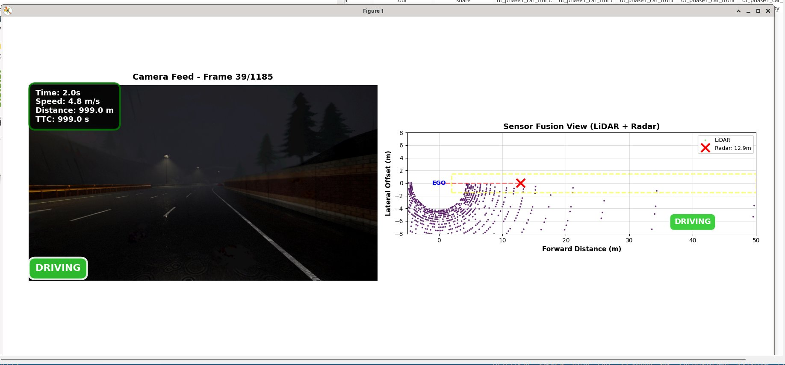
PHASE 1 SIMULATION
CARLA Simulation Setup & Results
Scenario Design
Town04 long straight, deterministic + repeatable
Stationary obstacle ~80m ahead, lane-aligned
Synchronous mode, fixed timestep
Safety State Machine
SAFE → WARNING → CRITICAL (TTC<2s or dist<8m)
POST-STOP → LANE CHANGE → RESUME driving
89%
8%
<2s
114 FPS
Clear conditions DRIVING state
SAFE state
CRITICAL
TTC trigger
YOLOv8n
7
Night rain LANE_CHANGE triggered

Slide 9
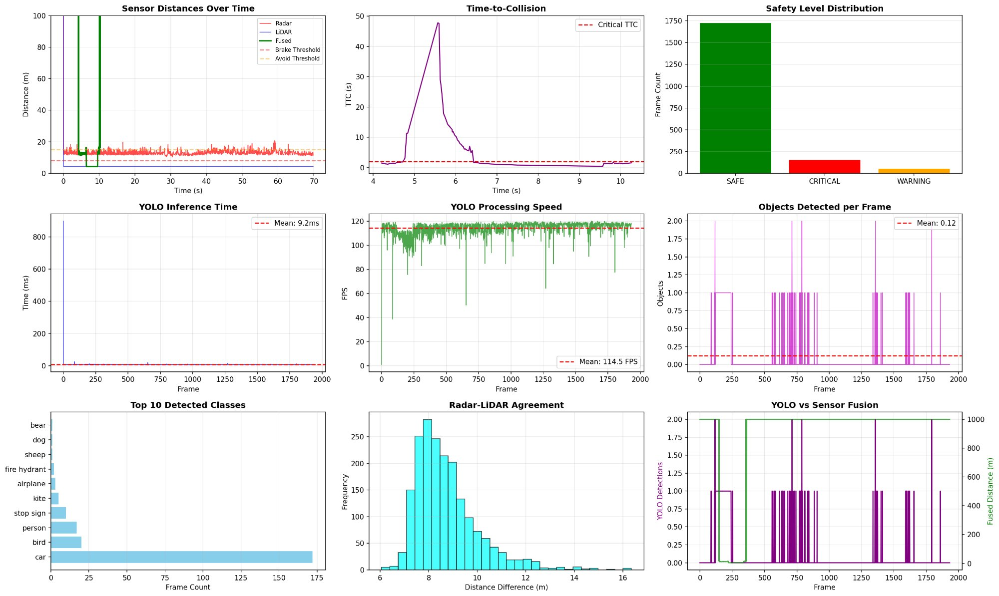
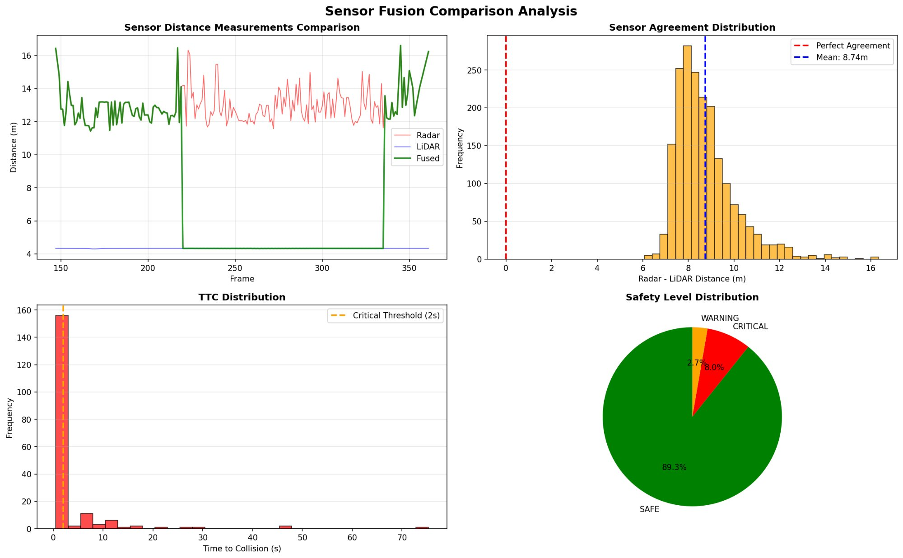
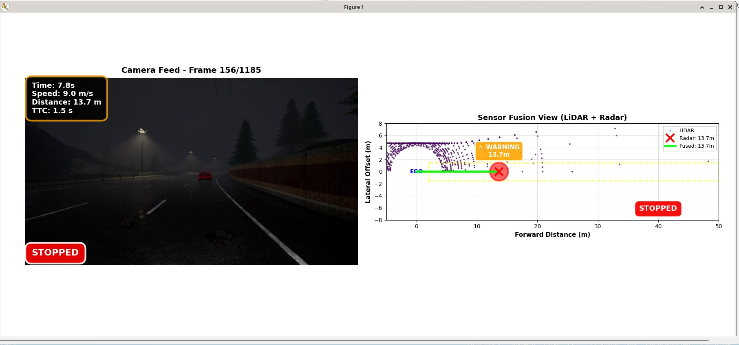
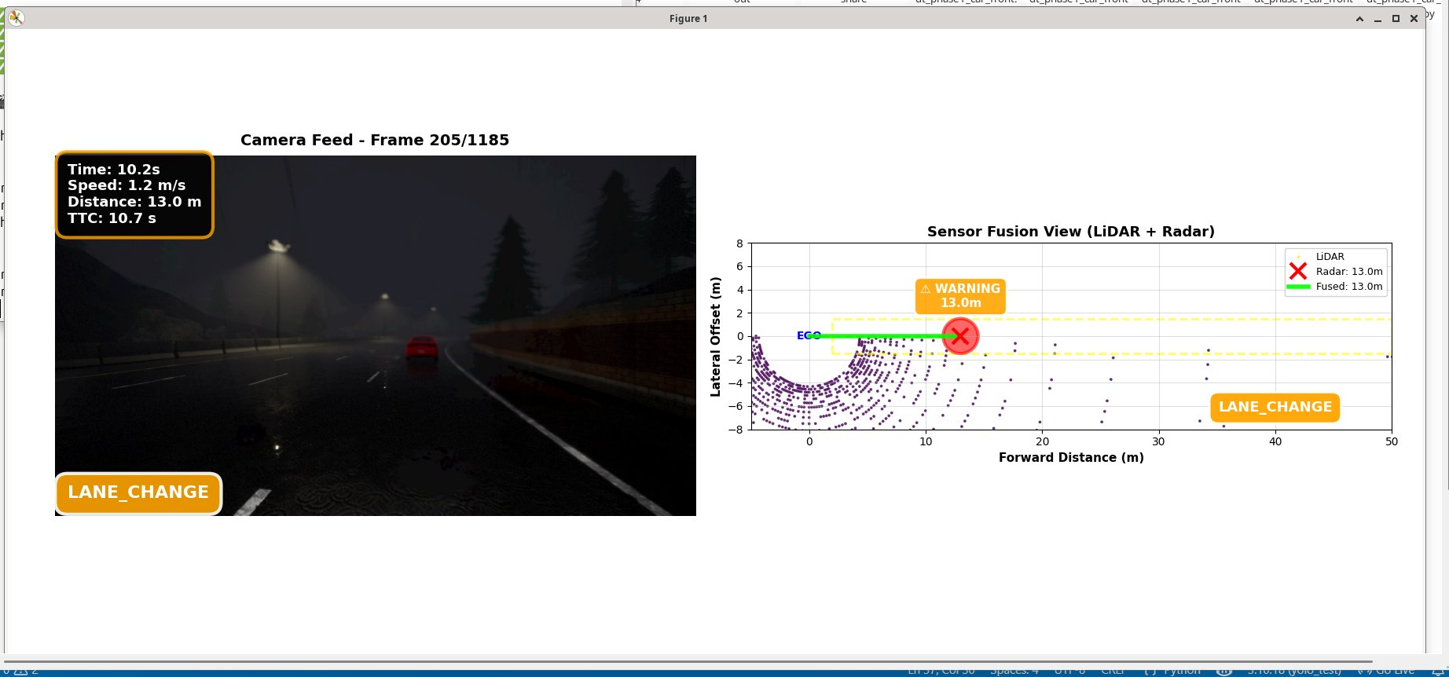
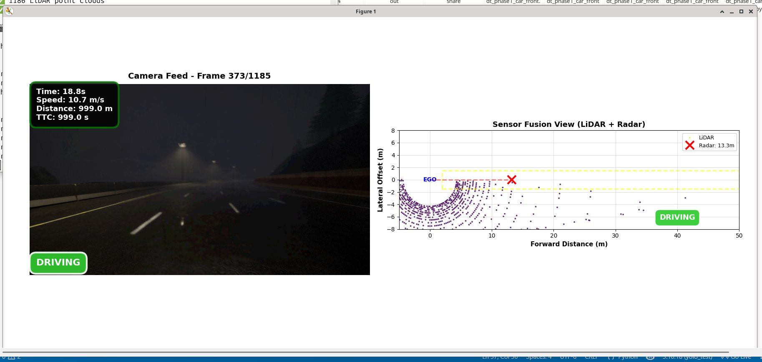
PHASE 1 RESULTS
CARLA Simulation Analysis Results
Rain LANE_CHANGE
Rain STRAIGHTENING
Rain RESUME
Night rain DRIVING
Key Finding: Gated sensor fusion correctly suppressed false positives. TTC-based braking triggered only when genuinely required CRITICAL state only 8% of total run time.
8

Slide 10
PHASE 2 ARCHITECTURE
Phase 2: Real Hardware Architecture
LD06 LiDAR
Jetson Orin Nano
Arduino Uno R4 WiFi
RC Car
LD06 @ 230400 baud
±20° FOV • 47-byte packets
USB → Jetson
Primary AI node
LiDAR pipeline
Camera + YOLOv8n
Fusion logic
Digital twin layer
UDP → Arduino :5005
Motor control bridge
ESC: pin 9
Servo: pin 10
UDP :5005 → PWM
5V signal output
ESC pin 9
Servo pin 10
Motor drive
▶
IMX477 Camera
Arducam B0249 • CSI
416×416 GStreamer
YOLOv8n CUDA
UDP :5005
▶
▶
▶
Pi 5 + BGT60TR13C
DreamHAT+ mmWave radar
Full FMCW FFT pipeline
UDP :9576
▶
Key Engineering Finding: Jetson 3.3V GPIO insufficient for MSC-25RC ESC (needs 5V). Resolved by routing motor control through Arduino Uno R4 WiFi outputs correct 5V PWM via Servo library.
9

Slide 11
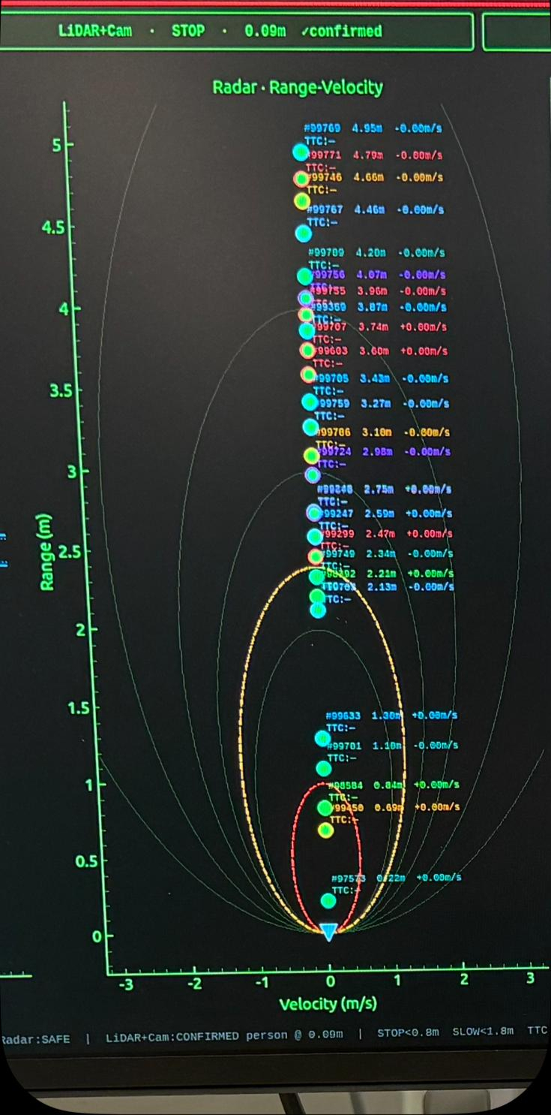
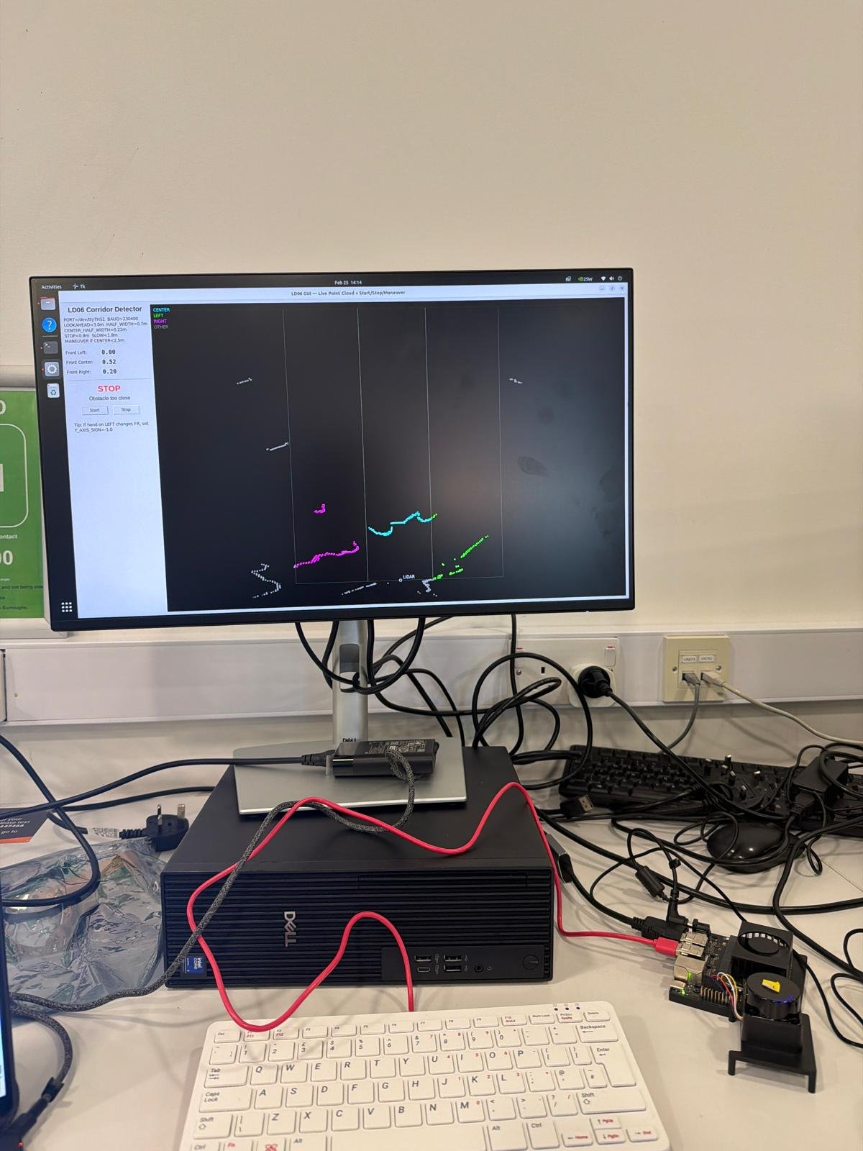
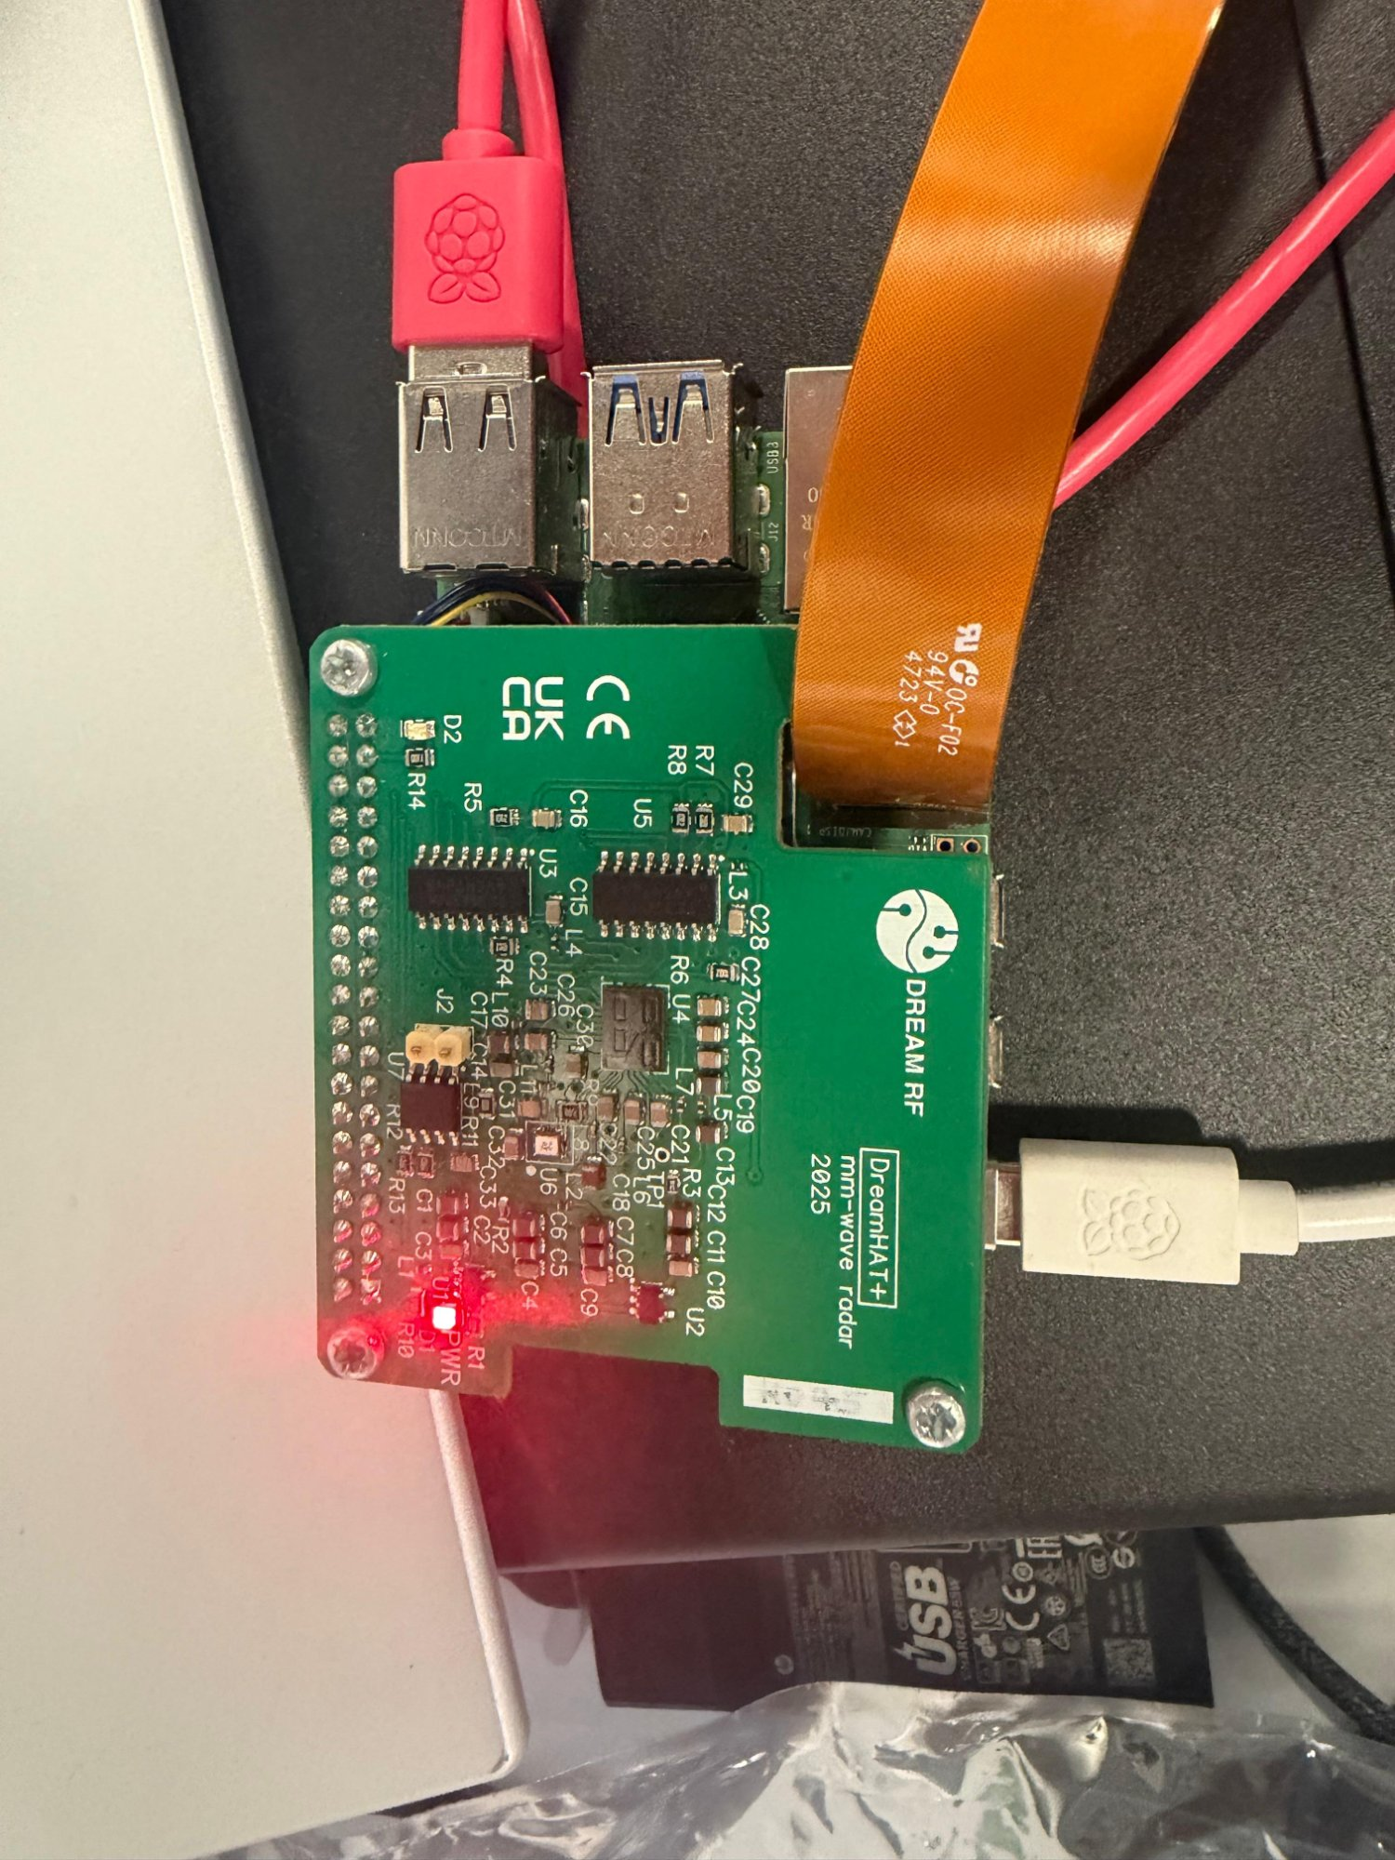
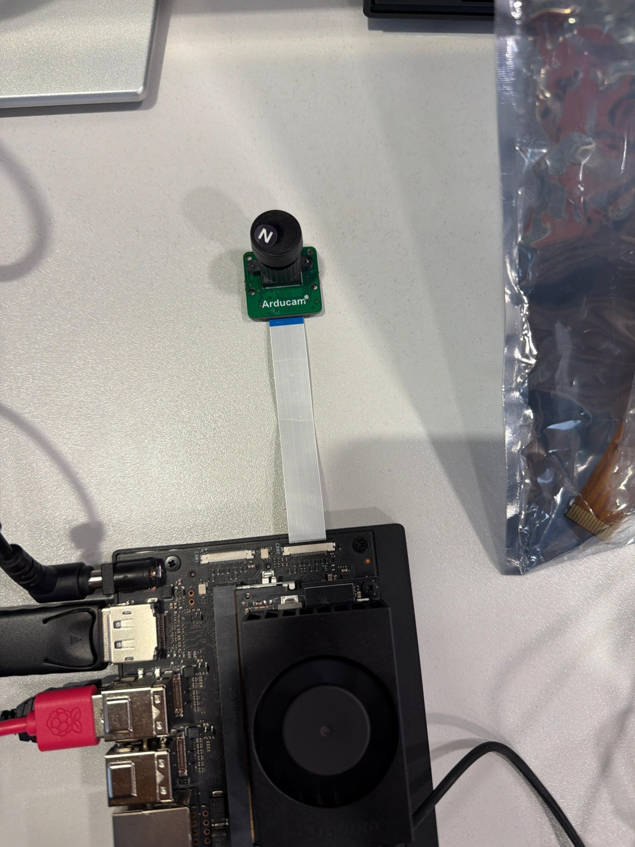
PHASE 2 REAL HARDWARE
Hardware Platform Physical Build
Maverick RC Chassis
Jetson Orin Nano
4WD, 8–12 kg payload
ESC: MSC-25RC (5V signal)
Steering servo pin 10
Primary AI node
LiDAR + Camera + Fusion
YOLOv8n on CUDA
Raspberry Pi 5
Arduino Uno R4 WiFi
Secondary radar node
Full FMCW FFT pipeline
UDP → Jetson port 9576
Motor control bridge
ESC pin 9 / Servo pin 10
UDP 5005 → PWM
Key Finding: Jetson 3.3V GPIO insufficient to drive MSC-25RC ESC (5V required). Resolved by routing motor control through Arduino Uno R4 WiFi.
10

Slide 12
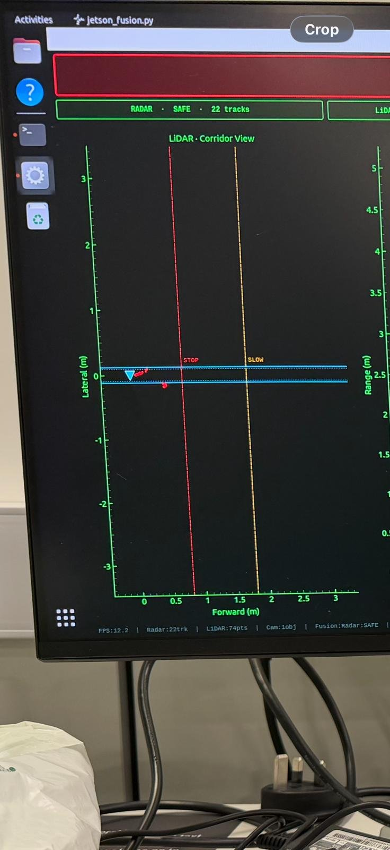
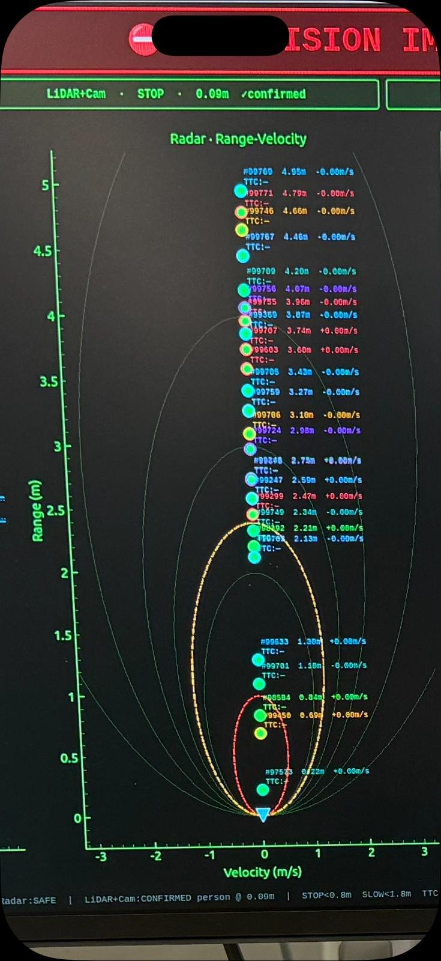
PHASE 2 SENSOR PIPELINES
LiDAR, Radar & Camera Pipelines
LD06 LiDAR
BGT60TR13C Radar
IMX477 + YOLOv8n
47-byte packets @ 230400 baud
Zero-degree offset fix applied
FOV cut to ±20° forward only
20cm minimum distance floor
Min-points/zone threshold (scales with distance)
Persistence: raise 3 frames, clear 4 frames
Degraded: 0 forward pts for 15+ frames
(3 RX, 64 chirps, 128 samples) per frame
Range FFT → Doppler FFT → Angle FFT
MTI clutter suppression (coeff 0.92)
CFAR detection at 16 dB threshold
Nearest-neighbour tracker, 3-frame confirm
Approach gate: 3 consecutive neg-velocity frames
TTC: IMMINENT <1.5s | CAUTION <3s
GStreamer CSI → 416×416 hardware resize
Custom NVIDIA PyTorch + torchvision mock
Inference every 2nd frame (GPU load halved)
Forward zone: centre 40% of frame width
Bounding-box height → monocular distance
Mean brightness <40 → degraded, cleared
Cross-validation gating with LiDAR
11
LiDAR corridor — live bench
Radar range-velocity live bench
Arducam IMX477 on Jetson

Slide 13
PHASE 2 FUSION & NAVIGATION
Sensor Fusion & Autonomous Navigation
Fusion Decision Logic
Reactive Obstacle Avoidance
LiDAR | Camera | Result
Sees object | Confirms | CONFIRMED alert raised
Sees object | Nothing | CAUTION no Camera Data
Nothing | Sees object | CAUTION no range data
Nothing | Nothing | SAFE
SAFE
Drive forward ESC 1700µs
CAUTION
Slow down ESC 1570µs
IMMINENT
Full stop ESC neutral
Sensor Health Monitor
LiDAR zones (left/centre/right) steer away from detected obstacle. Re-centres once zone clears for 4+ consecutive frames.
Disconnected vs Degraded handled differently. LiDAR+Camera both impaired → floors at CAUTION. Never silently returns SAFE when blind on 2 of 3 sensors.
Control Chain
1. Fusion GUI (Jetson)
2. LiDAR Zone Analysis
3. UDP → Arduino Uno R4 WiFi
4. ESC (pin 9) + Servo (pin 10)
5. RC Car Motion
12

Slide 14
Thank You
Questions & Discussion
Raffay Hassan
BEng Computer Systems Engineering
Middlesex University London
Supervisor: Dr Purav Shah
rh960@live.mdx.ac.uk
Sensor-Driven Digital Twin Framework for Collision Prevention in Autonomous Systems | PDE3823
13

